Slide 1
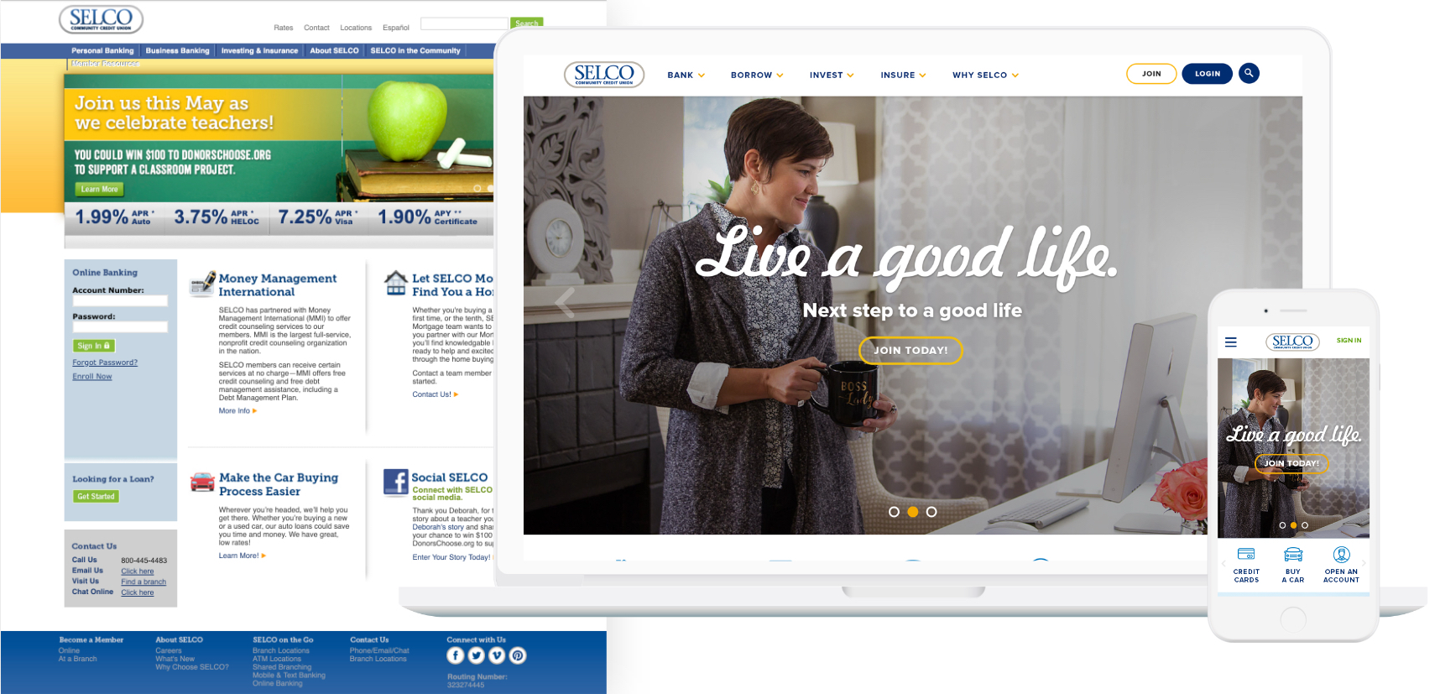
SELCO Credit Union
Before
After

Slide 2



SELCO Credit Union
Problem
Process
Outcome
Dated generic design that didn’t differentiate or align to customer needs
Low customer satisfaction for digital ecosystem
Poor SEO rankings
No research-based understanding of customer base
High volume of web-driven inbound support calls
Development of new Digital Brand
Heuristic evaluations and competitor research
Extensive user research, surveys, interviews, focus groups, interaction studies, journey mapping
SEO Research + Content Evaluation
Launch of new digital brand, with positive customer sentiment.
Defined customer journey
Drastically improved SEO rankings
Significant decrease in inbound customer service calls related to challenges with online experiences

Slide 3
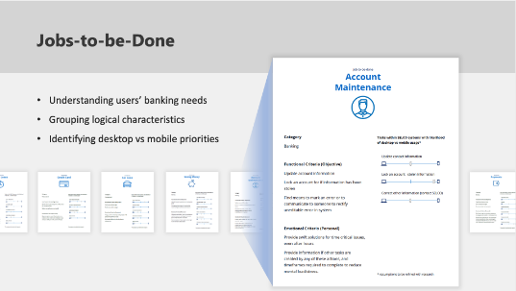
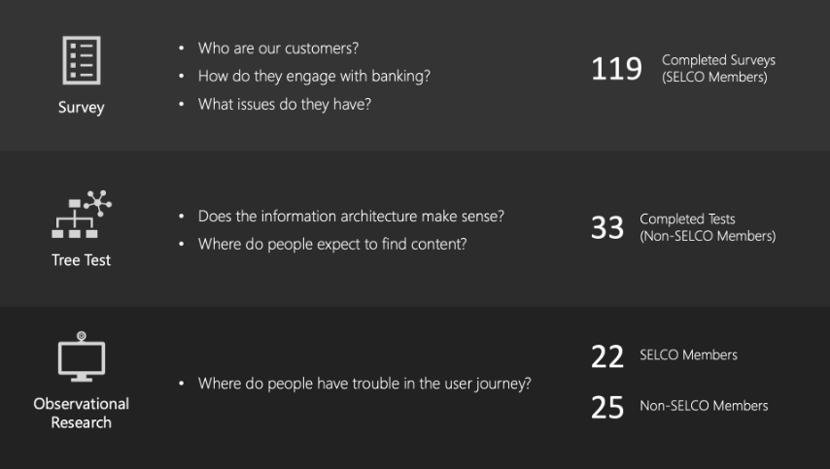
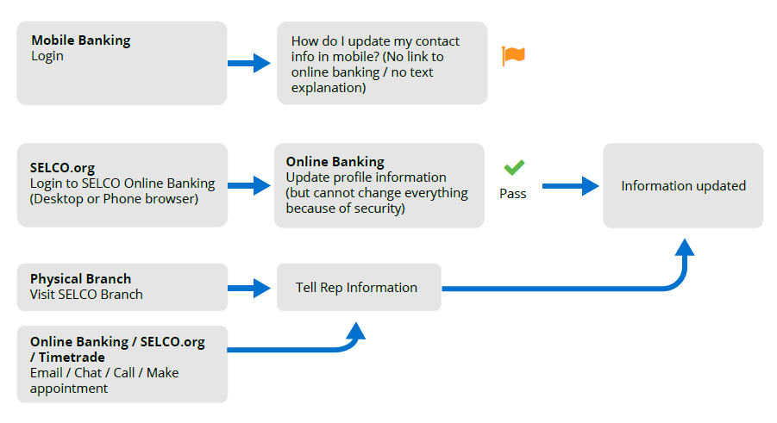
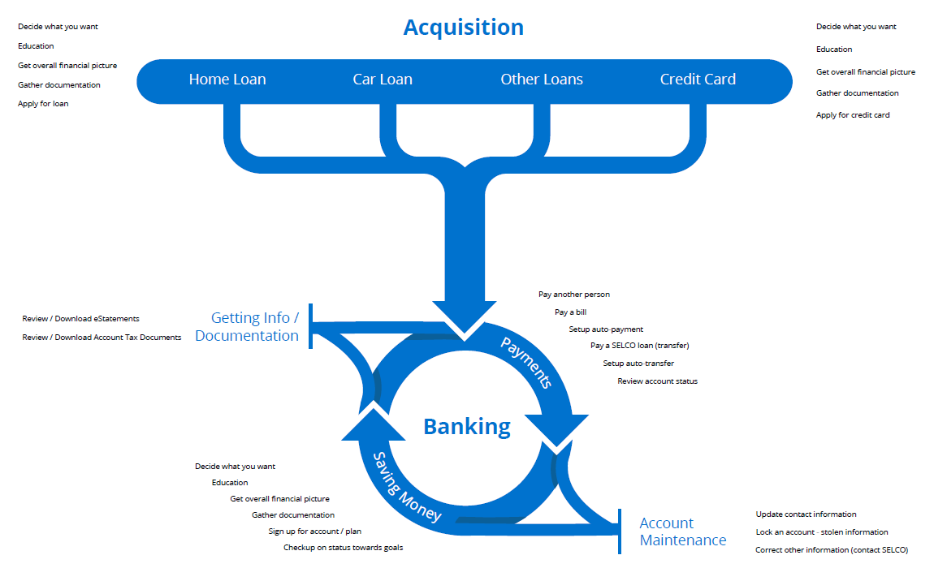
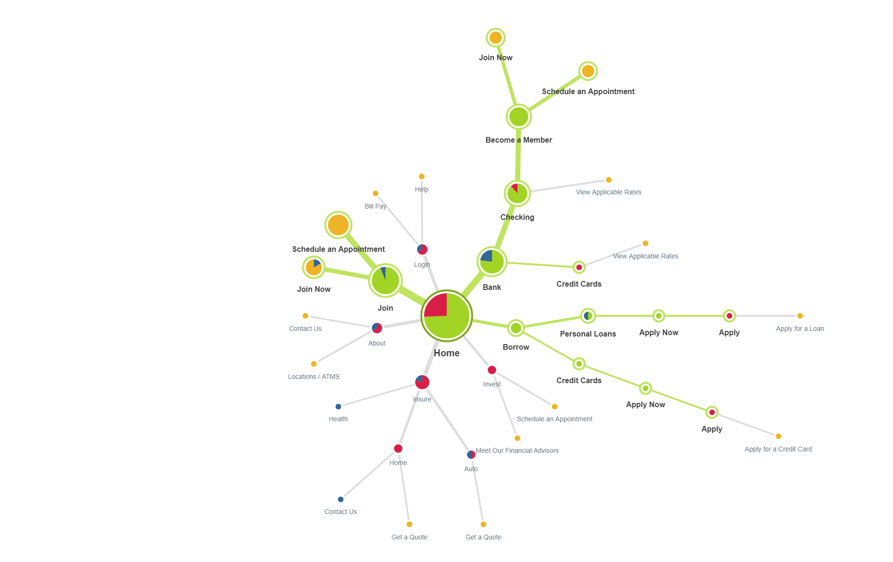
SELCO Credit Union
SELCO Credit Union is an Oregon based financial institution that was looking to expand their footprint, grow their user base, improve their end-to-end digital experiences, and SEO. To begin, we first needed to understand their customer base.
We gathered relevant, actionable insights on SELCO’s customer base. Distilled and presented our findings to SELCO’s board that informed and guided the roadmap of their digital experience overhaul.
What we did
Heuristic evaluation of all digital systems
Stakeholder interviews
User journey mapping with focus on jobs-to-be-done, and how they flow together as a whole.
Detailed user research plan and expected outcomes.
Scheduling, recruitment, and creation of testing materials and scripts.
Execution of remote and in-person research, including surveys, tree testing, and observational testing with existing designs.
Analysis and report creation for all user research conducted.
Final presentation to board members describing all work conducted and the value to their institution.
119
33
47
Members Surveyed
IA and Journey studies
User interviews and observational studies

Slide 4
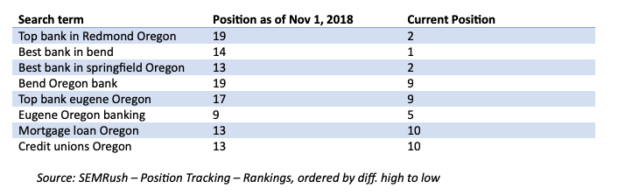
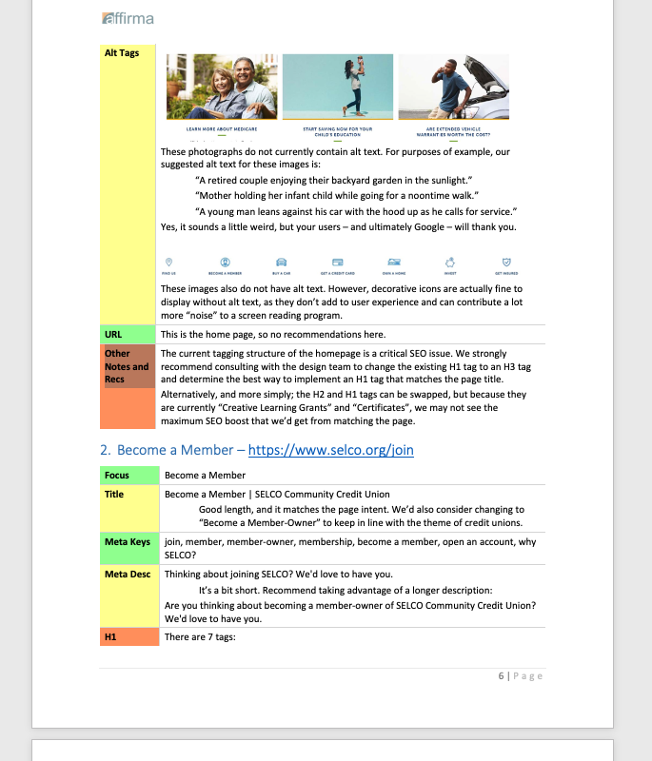
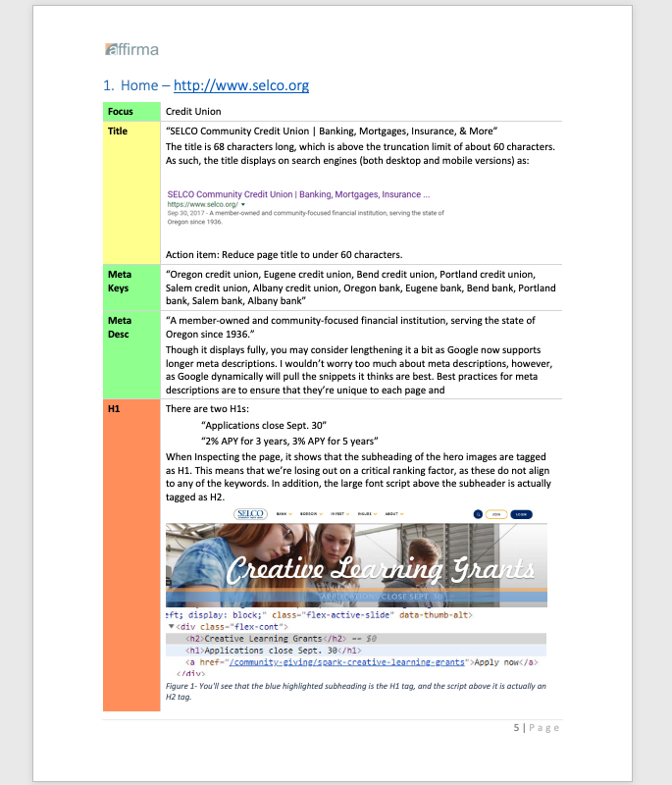
SELCO CU - SEO Strategy & Execution

